Slide 1
Prediction of Olfactory Perception Based on the Molecule’s Properties
Introduction to Machine Learning for Neuroscience
Yonatan Goldstein
Ofir Sade

Slide 2
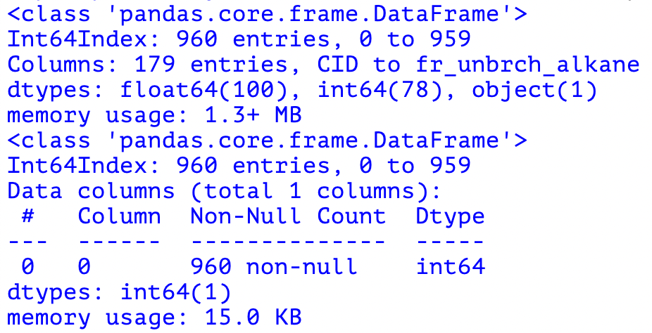
Preprocessing
Initially, we needed to organise the data and match the relevant subjects’ evaluations to the odour’s moleular descriptors.
For this purpose, we translated the substances’ CIDs to SMILES and merged the evaluations to the relevant molecular descriptors.
We decided to label each observation in the following manner:
Firstly, we calculated the average score each substance got in each possible odour descriptor (edible, sweet, fish, garlic, spices, cold, sour, etc…).
We then picked the 3 descriptors with the highest average and that list was used to create the label.
If this list contained the ‘sour’ descriptor, we considered it as sour (1).

Slide 3
Feature Selection
BORUTA
In order to find the best choice of features from the dataset we decided to use Boruta which was used in Chacko et. al, 2020.
Correlations Matrix (Pearson/Spearman)
After Choosing the features with the highest importance according to Boruta, we generated a Pearson correlations heatmap, in which we would expect to see whether any of the remaining features are redundant due to high correlation.
This step was carried out for each model we considered; the results will be discussed later on.

Slide 4
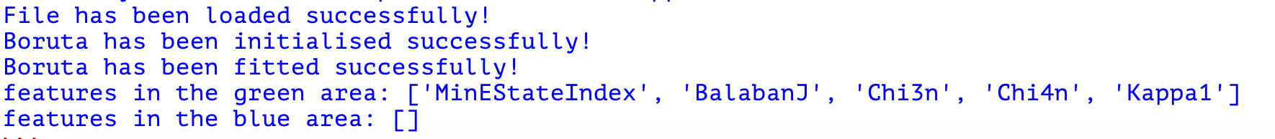
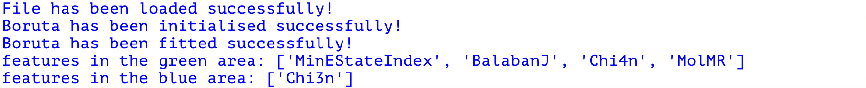

Slide 5
Oversampling with ADASYN Introduction
Due to the relative lack of data categorised as sour in comparison with data not categorised as sour, we decided to use ADASYN for oversampling of the minority group (odours categorised as sour).
ADASYN essentially creates a sufficient amount of synthetic data from the minority group of the data in an effort to even out the types of data the model learns from so the learning process may be less skewed.

Slide 6
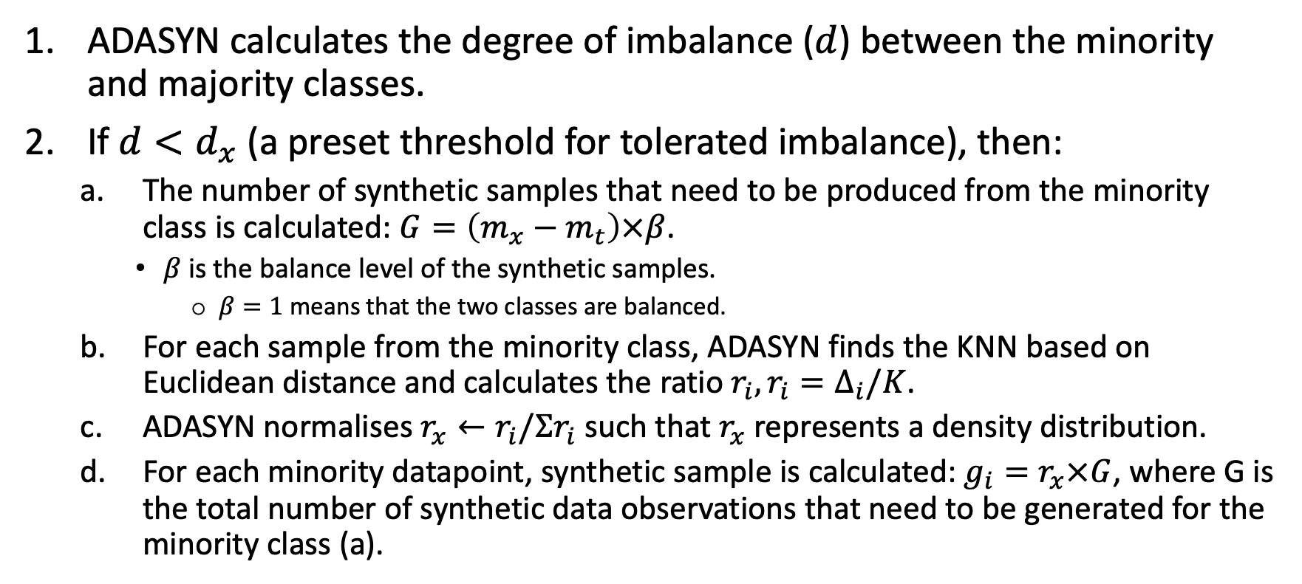
Oversampling with ADASYN – Practical Steps (I)
ADASYN calculates the degree of imbalance ($d$) between the minority and majority classes.
If $d<d_{x}$ (a preset threshold for tolerated imbalance), then:
The number of synthetic samples that need to be produced from the minority class is calculated: $G=\left(m_{x}−m_{t}\right)×β$.
$β$ is the balance level of the synthetic samples.
$β=1$ means that the two classes are balanced.
For each sample from the minority class, ADASYN finds the KNN based on Euclidean distance and calculates the ratio $r_{i}, r_{i}=Δ_{i}/K$.
ADASYN normalises $r_{x}←r_{i}/Σr_{i}$ such that $r_{x}$ represents a density distribution.
For each minority datapoint, synthetic sample is calculated: $g_{i}=r_{x}×G$, where G is the total number of synthetic data observations that need to be generated for the minority class (a).

Slide 7
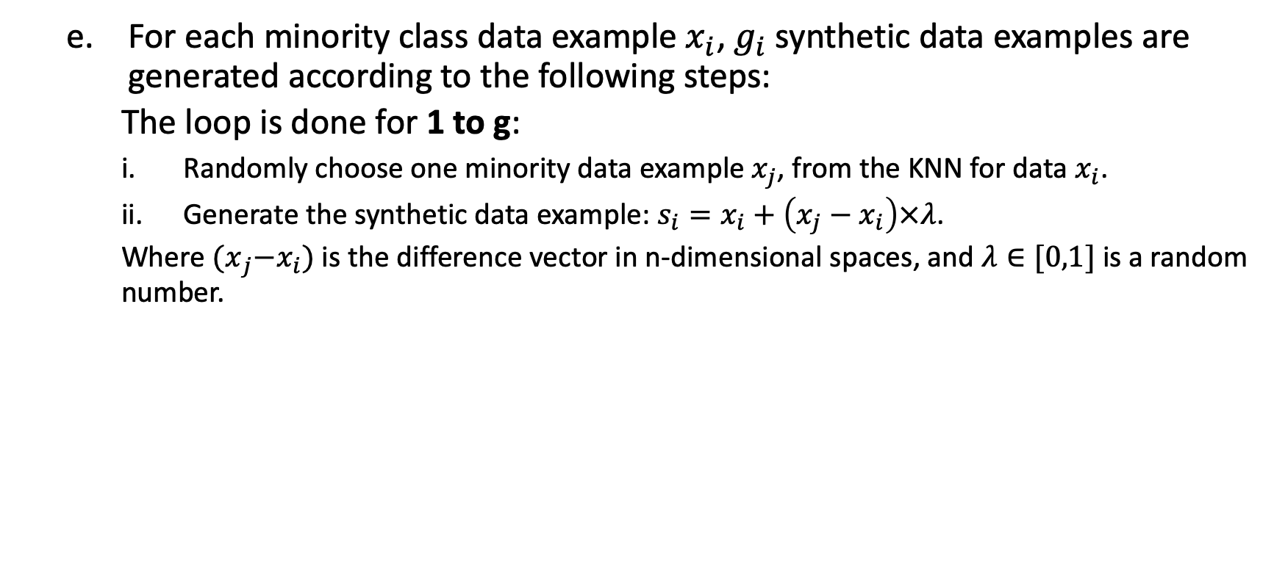
Oversampling with ADASYN – Practical Steps
For each minority class data example $x_{i}$, $g_{i}$ synthetic data examples are generated according to the following steps:
The loop is done for 1 to g:
Randomly choose one minority data example $x_{j}$, from the KNN for data $x_{i}$.
Generate the synthetic data example: $s_{i}=x_{i}+\left(x_{j}−x_{i}\right)×λ$.
Where ${(x}_{j}−x_{i})$ is the difference vector in n-dimensional spaces, and $λ∈[0,1]$ is a random number.

Slide 8
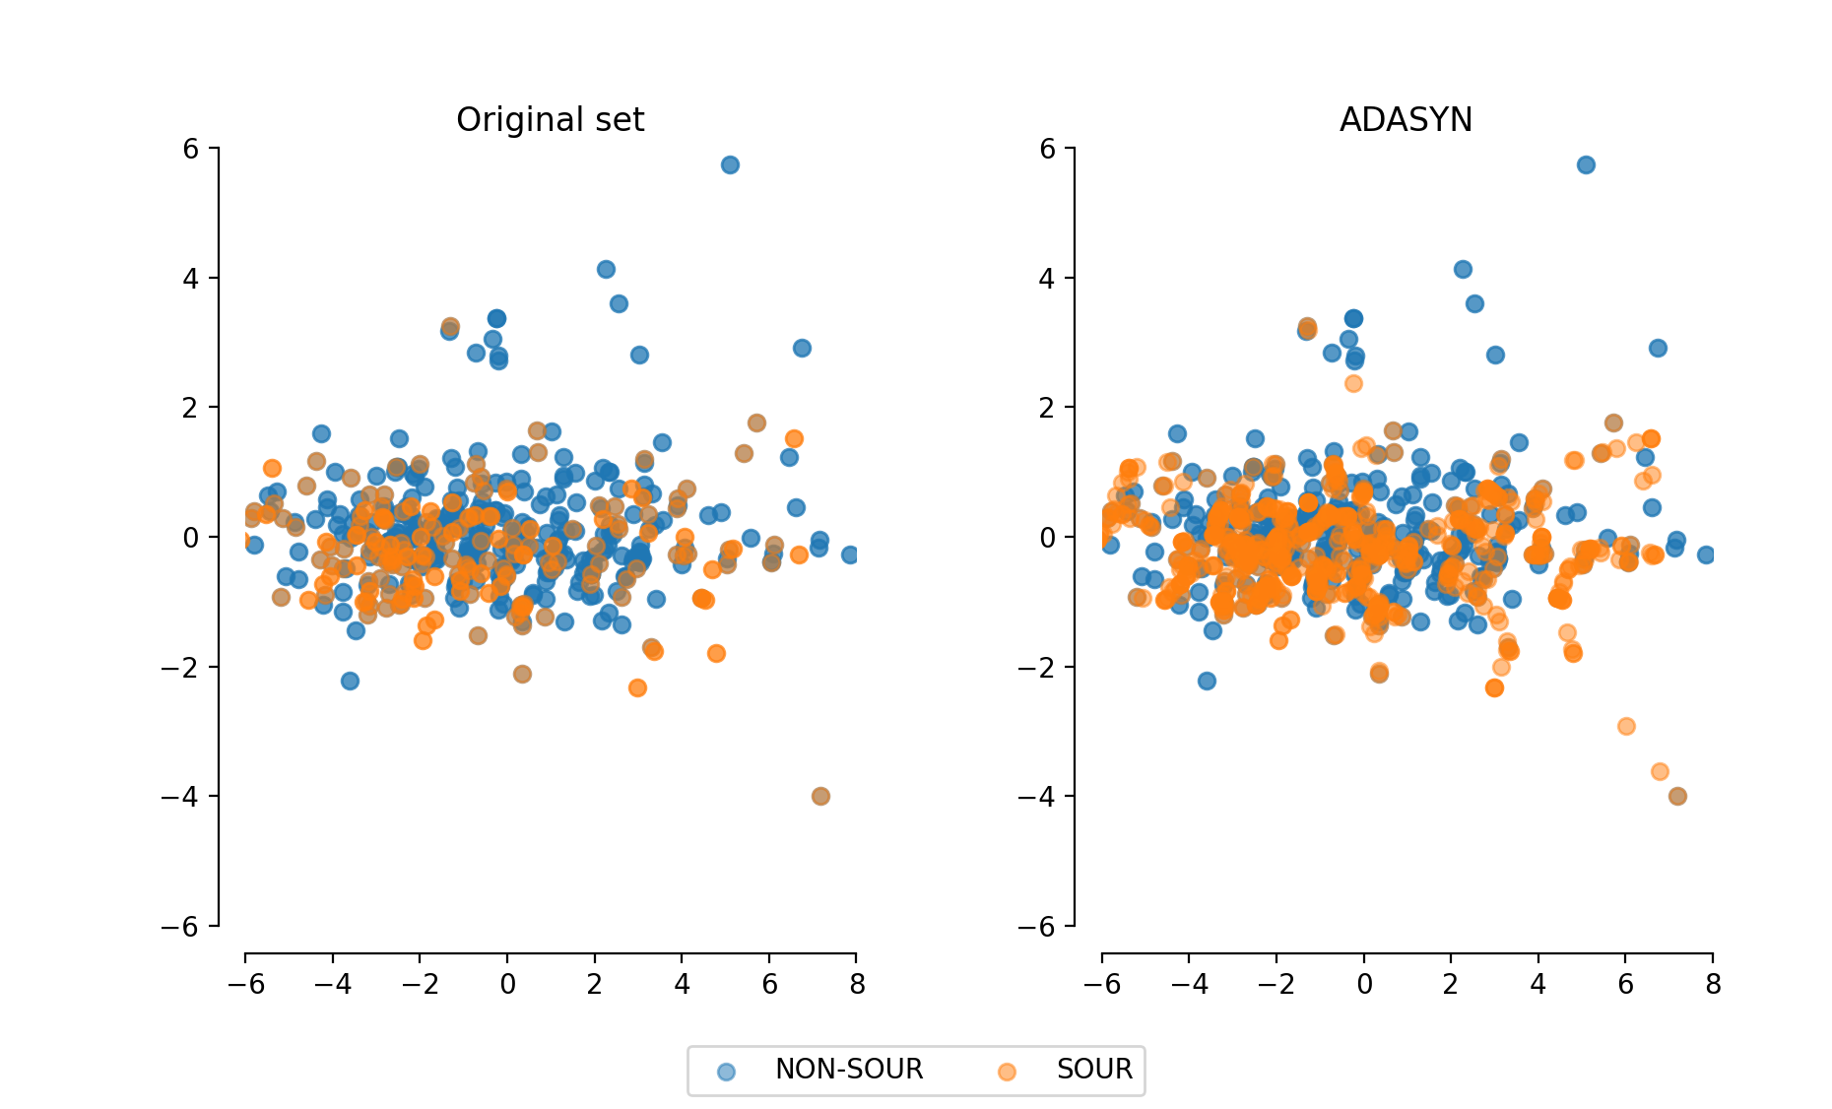
Oversampling with ADASYN – Visualisation

Slide 9
Model Selection
We considered the following supervised-learning models:
Random Forest Classifier
SVM
XGBoost
Logistic Regression
K-Fold Cross-Validation
We used 5-Fold Cross-Validation to avoid overfitting of the trained model.
We implemented this using GridSearchCV.

Slide 10
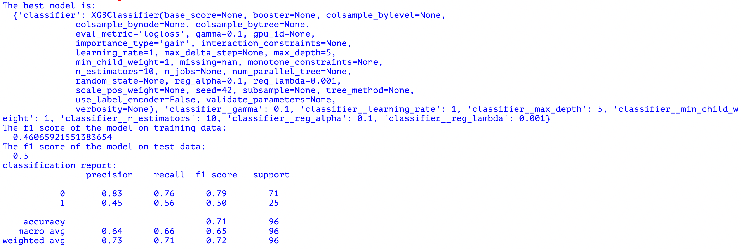
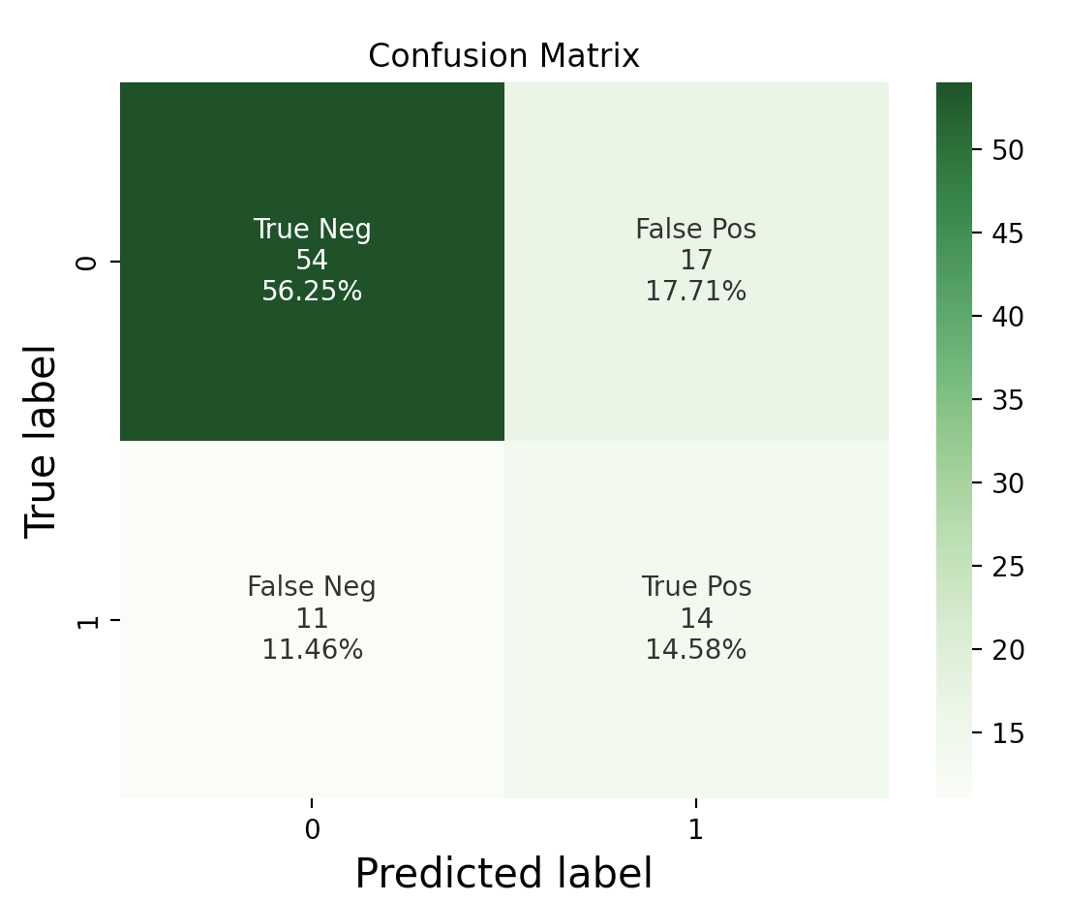
Confusion Matrices Before BORUTA (Feature Selection)

Slide 11
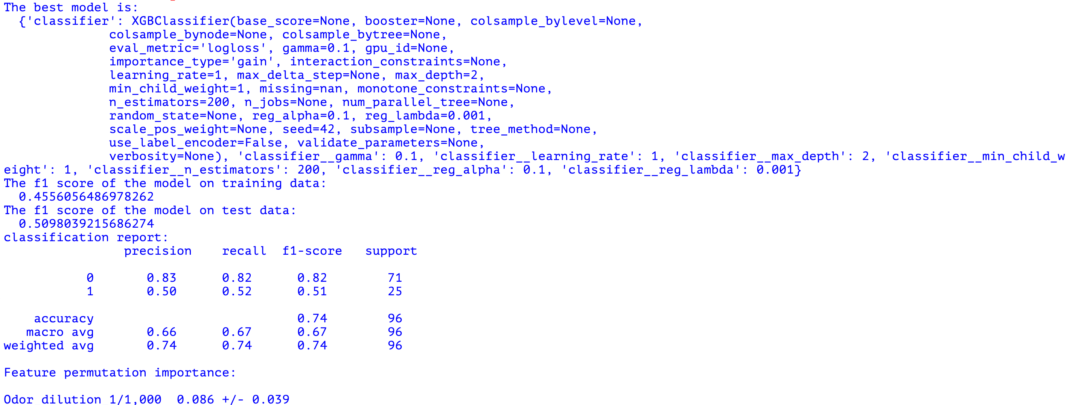
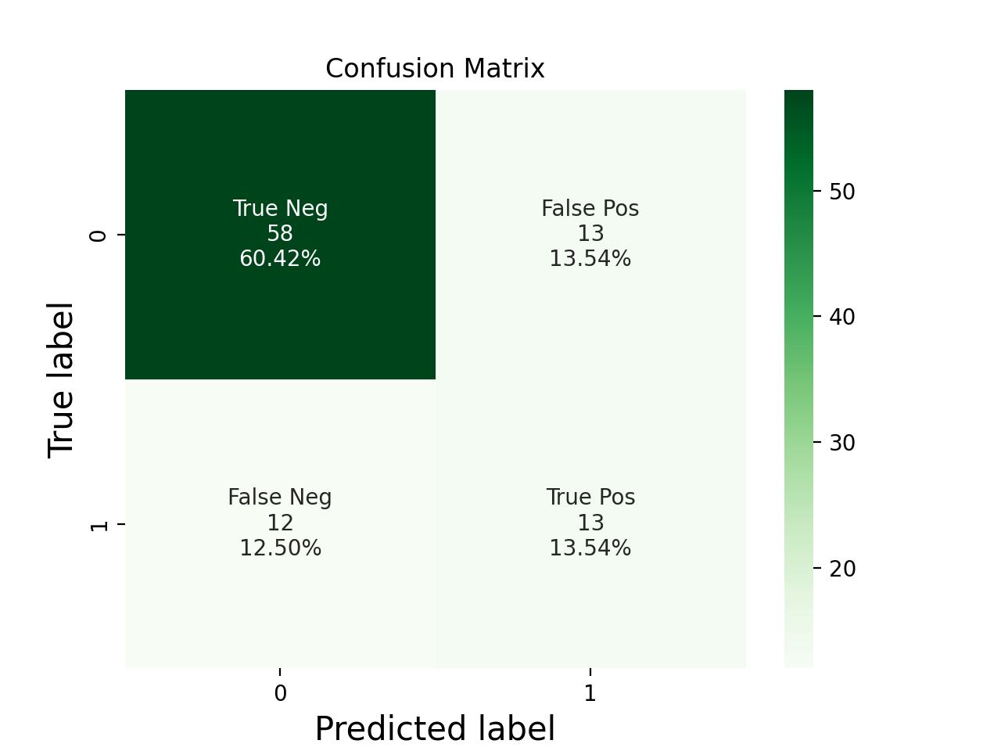
Confusion Matrices Before ADASYN (Oversampling)

Slide 12
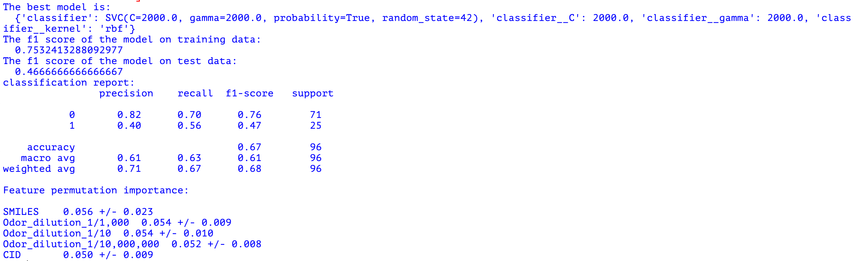
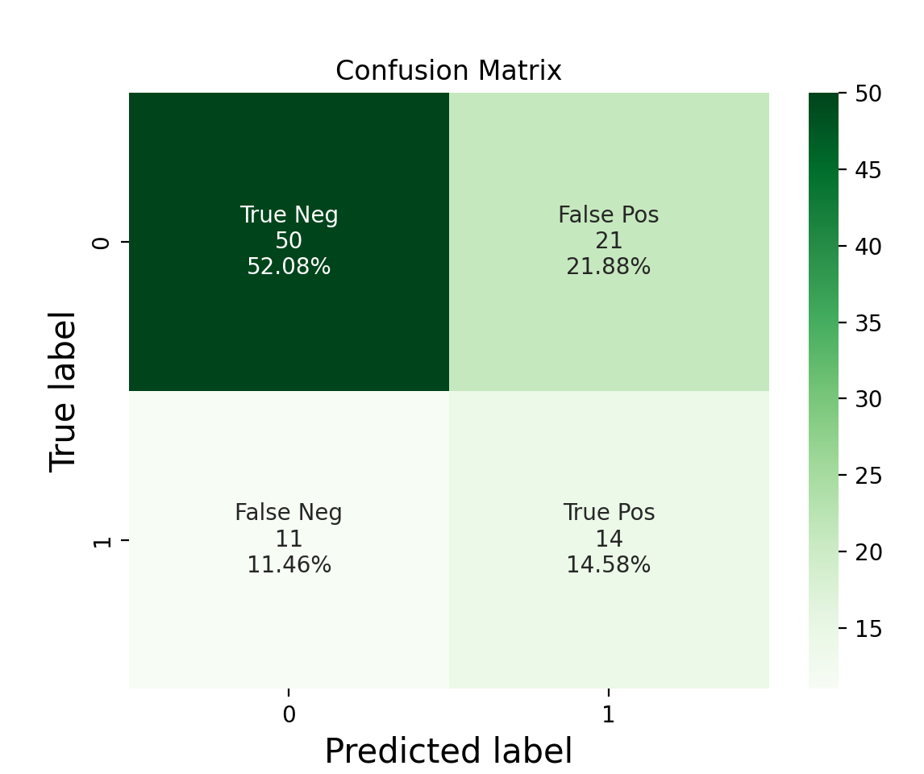
Confusion Matrices After Boruta & ADASYN

Slide 13
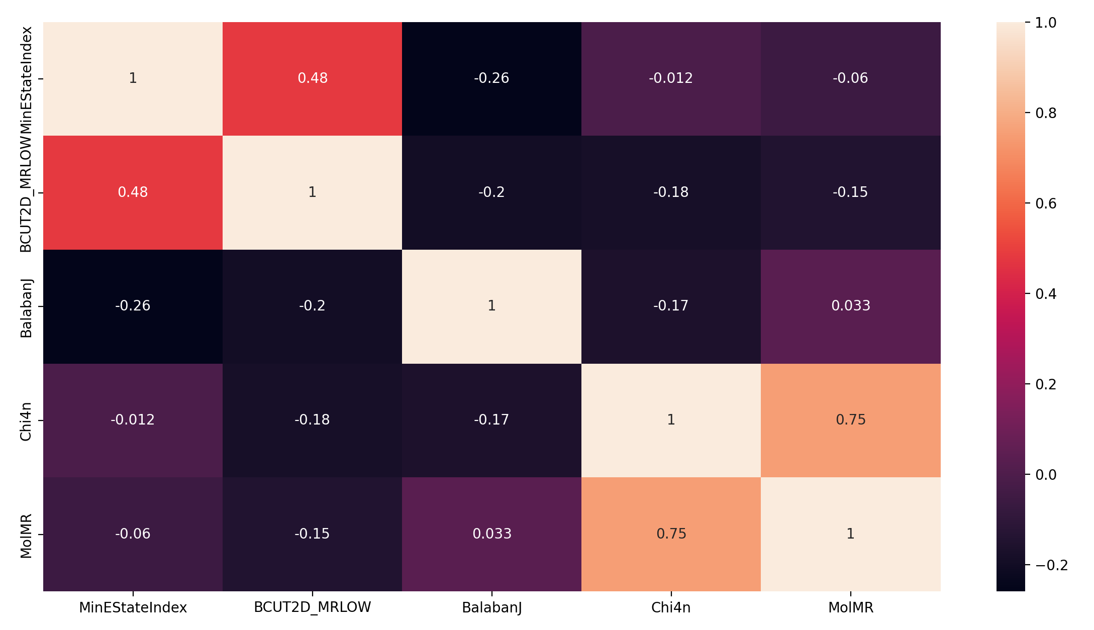
Feature Correlation After Boruta & Scaling
Notes:
The only ones with a very high correlation are Chi4n and MolMR…. Maybe we should consider dropping one of them?

Slide 14
The Final Model’s Performance Evaluation
F1 score (on the test set): 0.51
Accuracy: 0.74
Precision (weighted average): 0.74
Recall (weighted average): 0.74

Slide 15
Conclusions
Our initial “gut feeling” was that oversampling, more specifically ADASYN, would be a useful tool since the amount of “sour” substances are scarce in comparison with “non-sour” substances.
This was disproven by our results in most models, and specifically in our selected, optimal, model.
We found the optimal model to be SVM, with the addition of Boruta for feature selection.

Slide 16
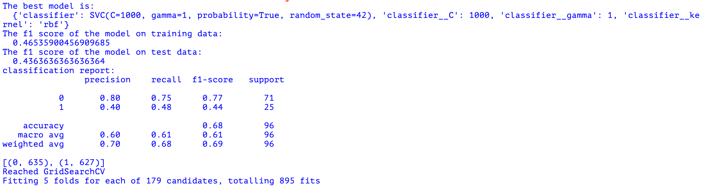
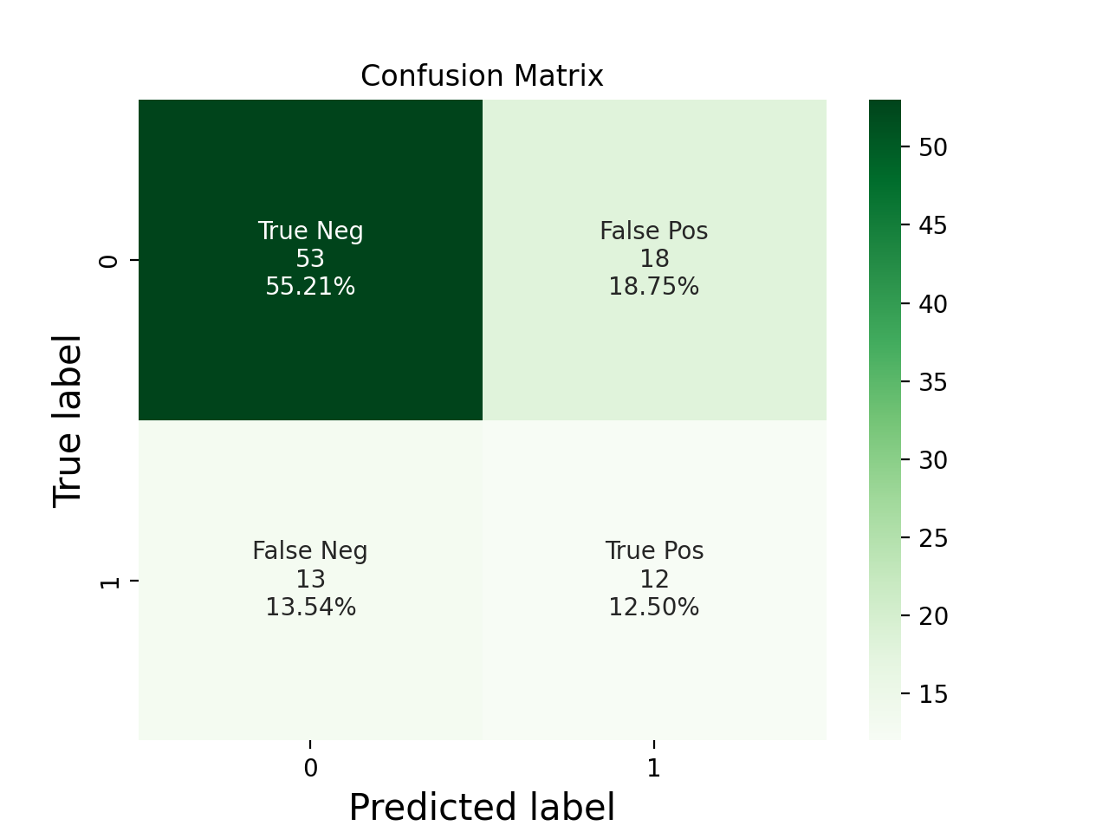
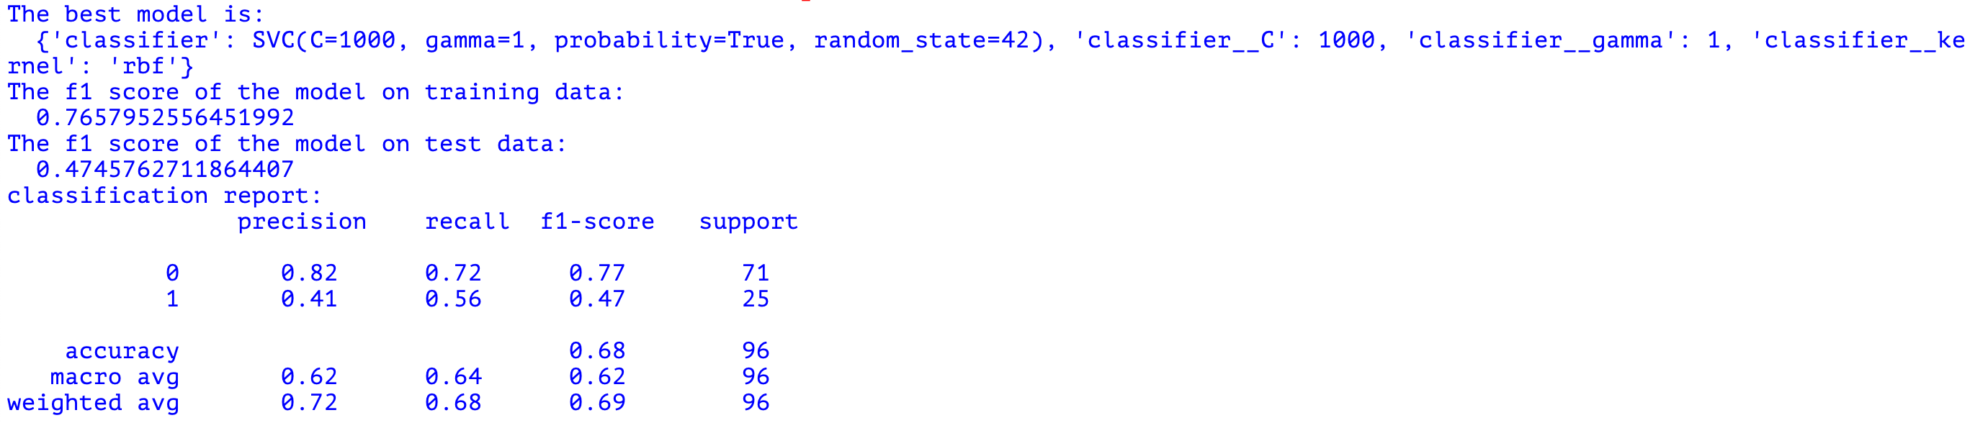

Notes:
SVM with my parameters

Slide 17
Notes:
SVM with Yonatan’s parameters

Slide 18
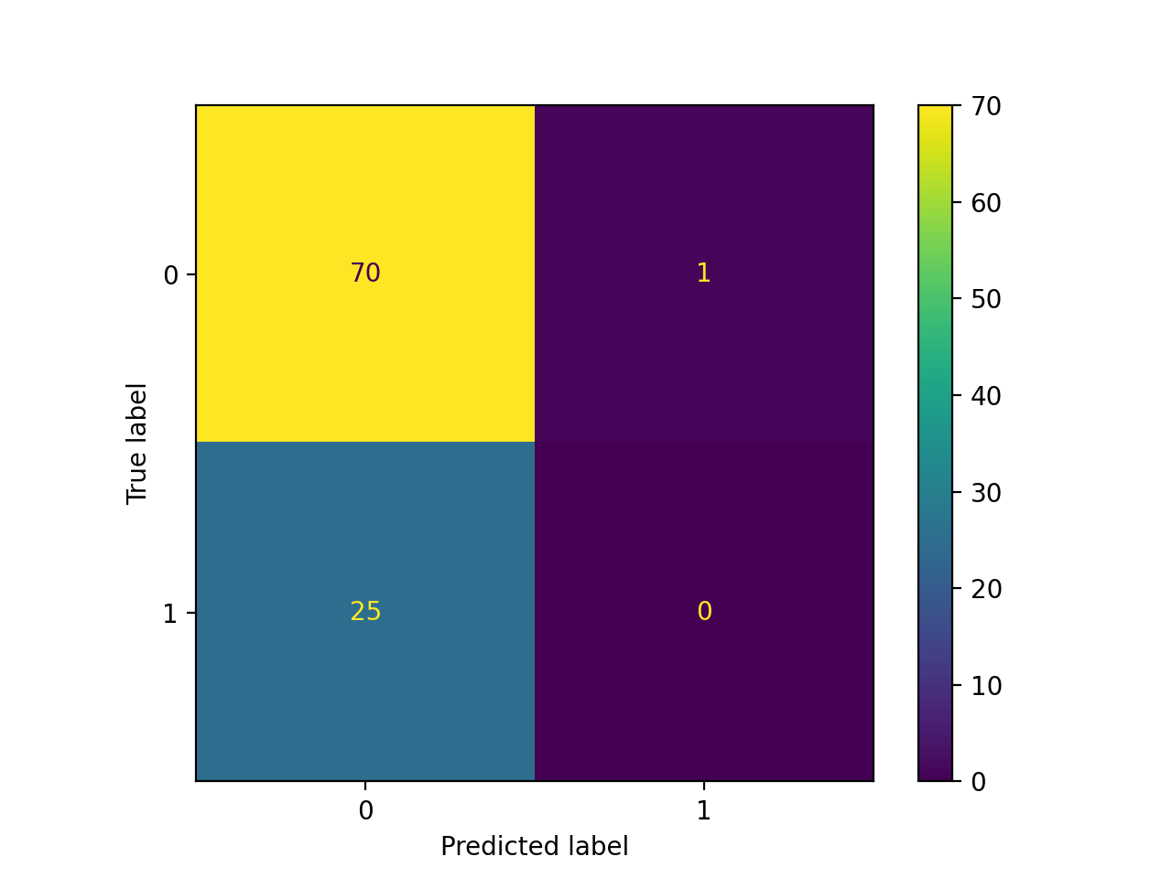
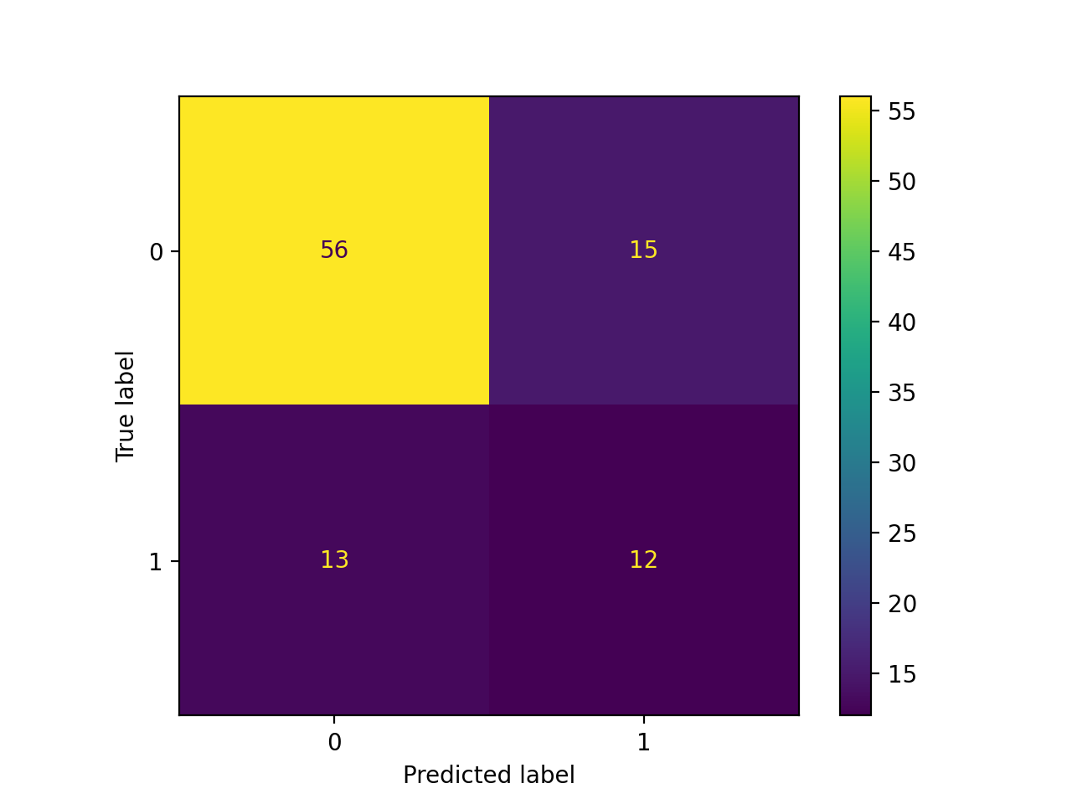
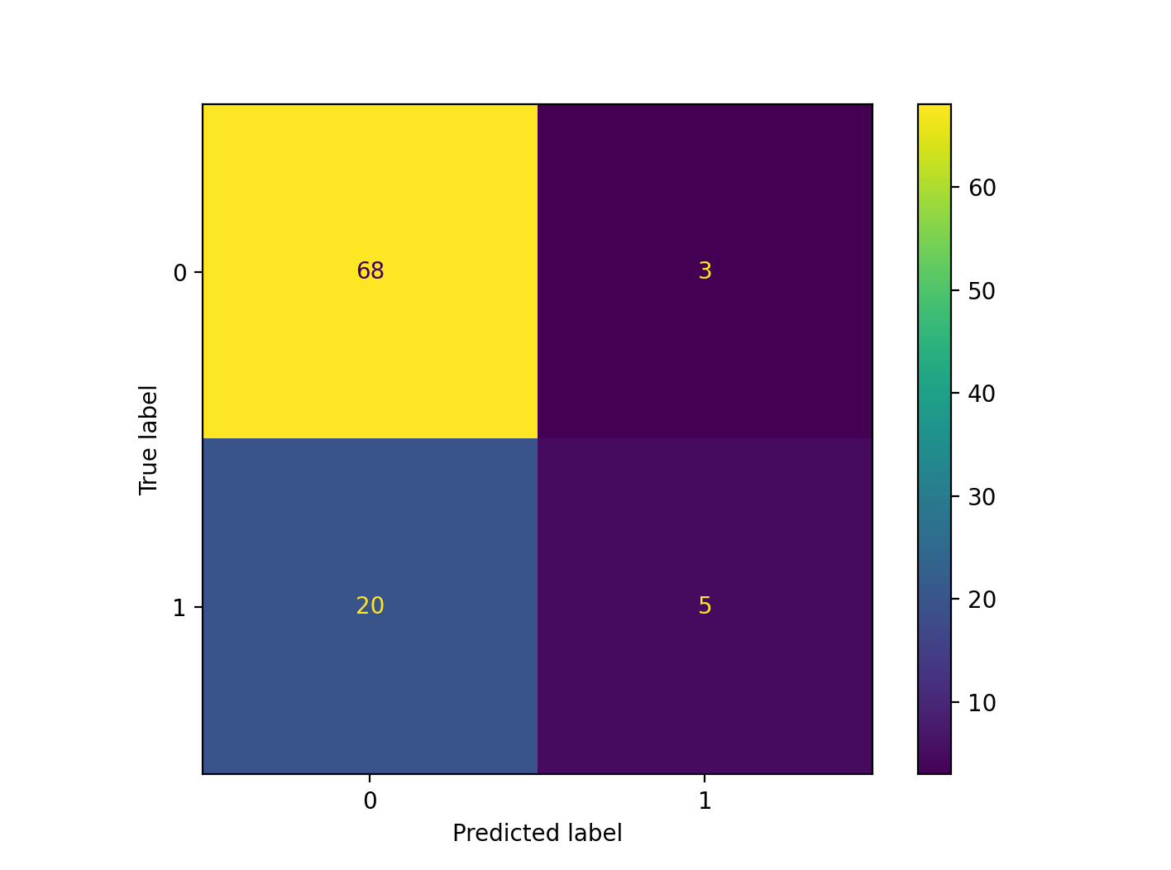
Confusion Matrices Before ADASYN
Param3
Param4
Param1

